Slide 1
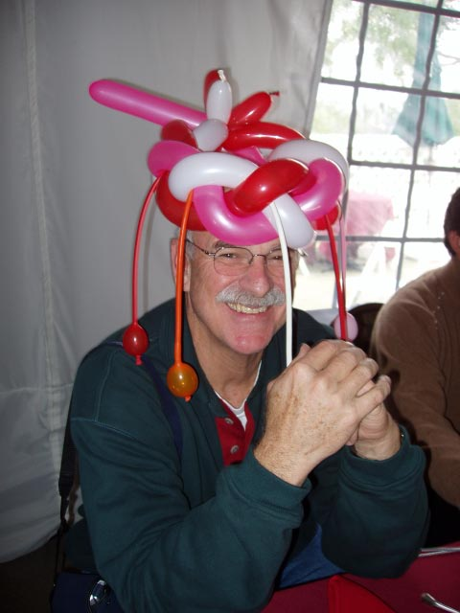
10 Positive Disruption Tools for
Use in the Classroom…
Mike Grimshaw
Executive Director
The Entrepreneurial Institute@CSUDH
mgrimshaw@csudh.edu

Slide 2
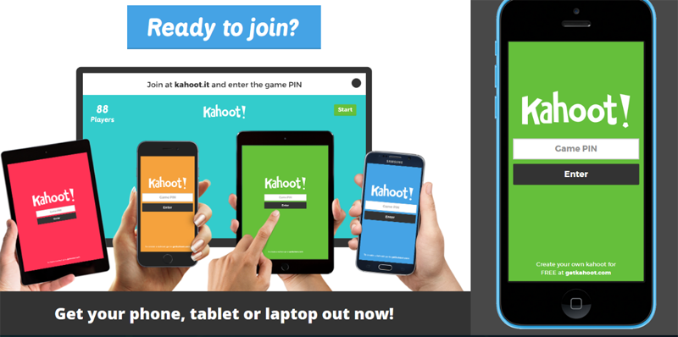
.com
Kahoot.com - Quiz/Review/Learn
Sharing Collaboration
Audience Interaction Tools
.com
Rational Debate Tool
Screen Capture Tools
Video Discussion Platform
This Photo by Unknown Author is licensed under CC BY-NC

